Slide 1

Fundamentals of Qiskit v1.0 and Quantum Circuit Design
Seonggeun Park
Korea University

Slide 2
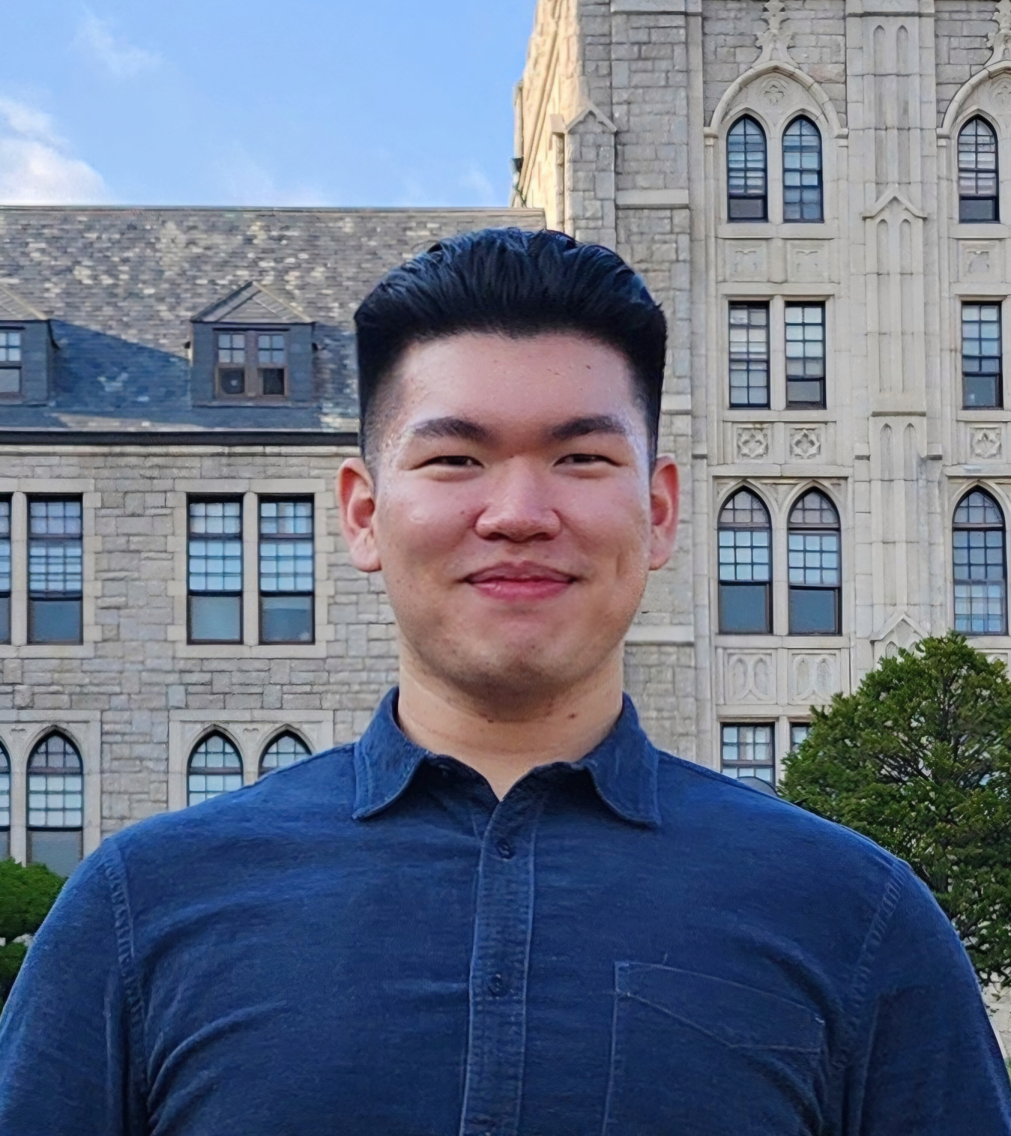

Seonggeun Park ssgg0926@korea.ac.kr
Undergraduate student at Korea Univ.
The president of QUICK
Center Director Prize, 2024 Quantum Information Competition
1st Place, MIT iQuHACK 2024, IonQ remote challenge division
9th Place, QHack 2024 coding challenge

Slide 3
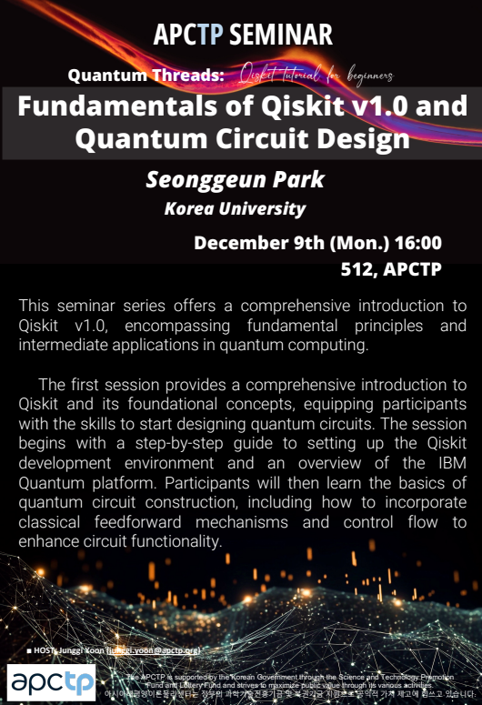
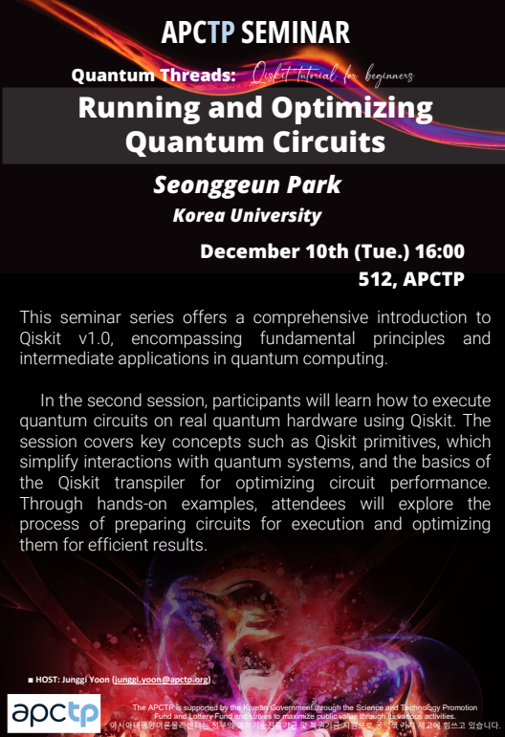
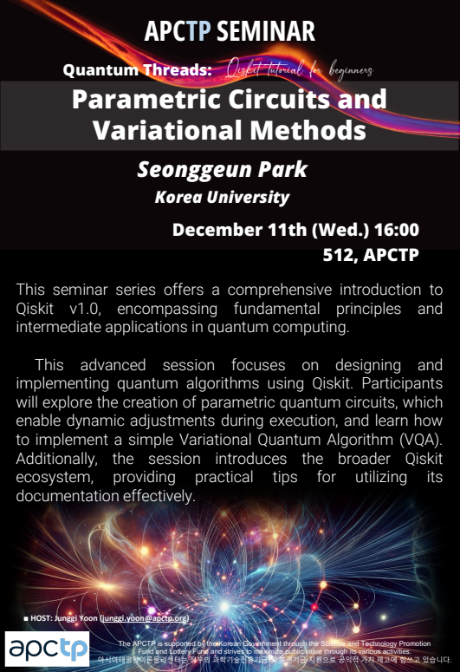
Qiskit Tutorial for Beginner Series at APCTP

Slide 4
Qiskit Tutorial for Beginner Series at APCTP
Overview of Basic Quantum Information
Introduction to Qiskit & IBM Quantum Platform
Setting Up the Qiskit Development Environment
Designing Quantum Circuits
Implementing Classical Feedforward and Control Flow
Exploring Qiskit Runtime Service
Executing Quantum Circuits using Qiskit Primitives
Transpiling Quantum Circuits
Implementing Parametric Quantum Circuits & VQA
Browsing the Qiskit Ecosystem

Slide 5
Qiskit Tutorial for Beginner Series at APCTP
Overview of Basic Quantum Information
Introduction to Qiskit & IBM Quantum Platform
Setting Up the Qiskit Development Environment
Designing Quantum Circuits
Implementing Classical Feedforward and Control Flow
Exploring Qiskit Runtime Service
Executing Quantum Circuits using Qiskit Primitives
Transpiling Quantum Circuits
Implementing Parametric Quantum Circuits & VQA
Browsing the Qiskit Ecosystem

Slide 6


Contents
A Quick Overview of Basic Quantum Information
Introduction to Qiskit & IBM Quantum Platform
Setting Up the Qiskit Development Environment
Designing Quantum Circuits
Implementing Classical Feedforward and Control Flow

Slide 7
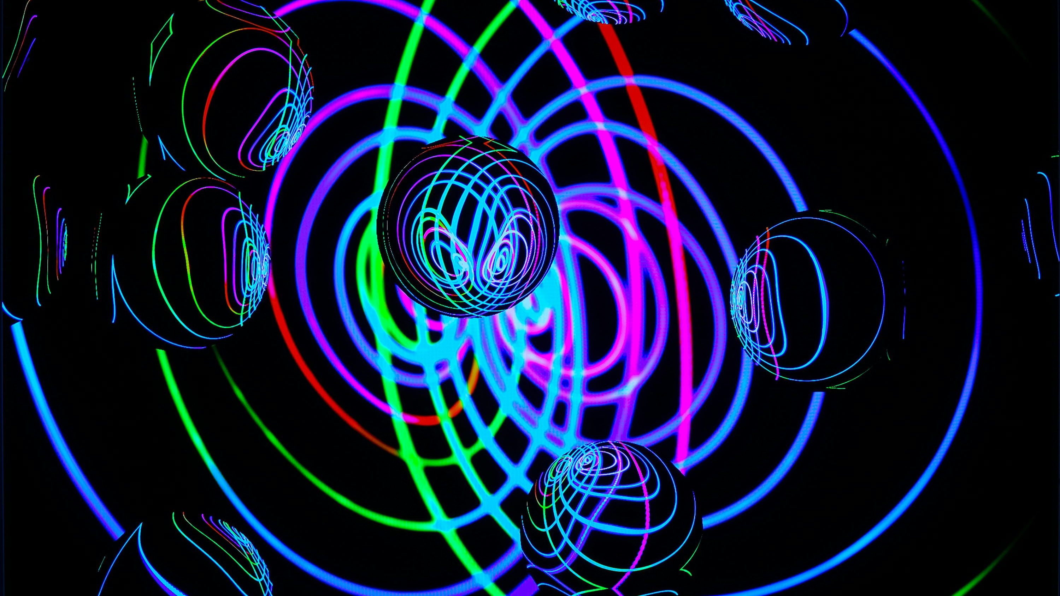
Ⅰ. Overview of Basic Quantum Information

Slide 8
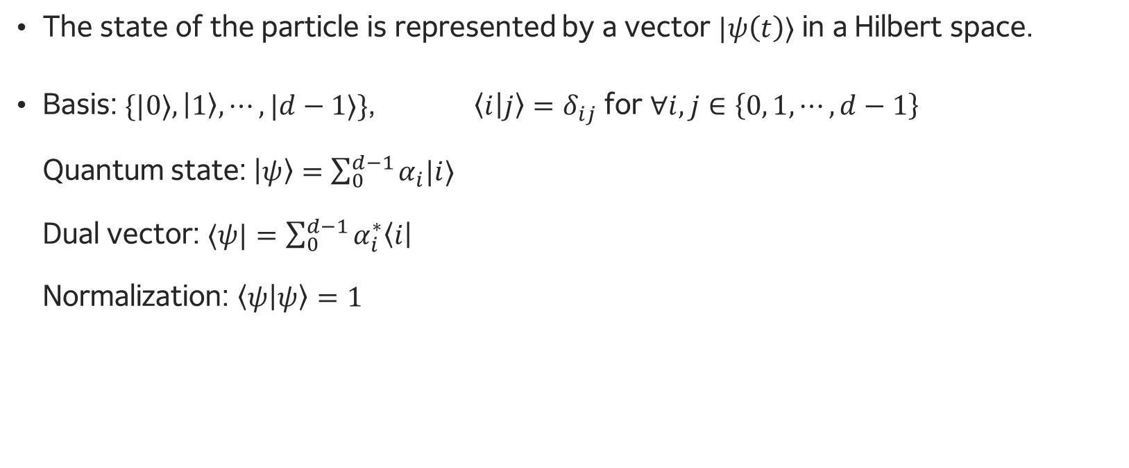
Quantum States
The state of the particle is represented by a vector $|ψ\left(t\right)⟩$ in a Hilbert space.
Basis: $\{|0⟩, \left|1\right\rangle , ⋯, |d−1⟩\}$, $\left\langle i | j\right\rangle =δ_{ij}$ for $∀i,j∈\left\{0, 1, ⋯, d−1\right\}$ Quantum state: $\left|ψ\right\rangle =\sum_{0}^{d−1}{α_{i}|i⟩}$ Dual vector: $⟨ψ|=\sum_{0}^{d−1}{α_{i}^{∗}\left\langle i\right|}$ Normalization: $\left\langle ψ | ψ\right\rangle =1$

Slide 9
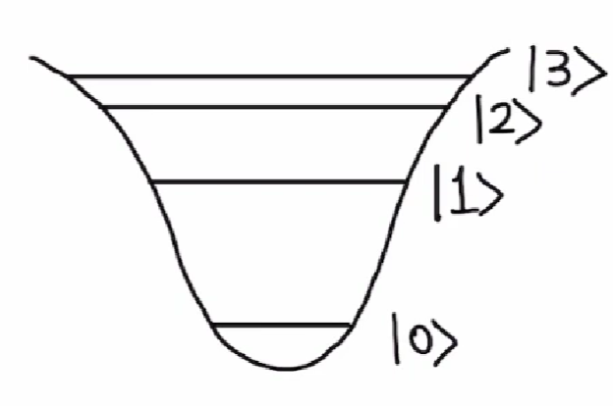
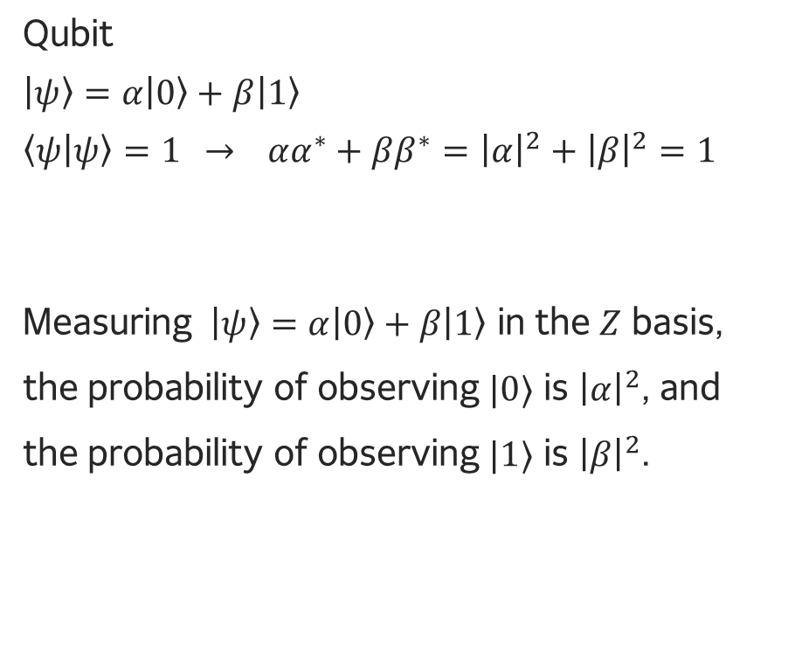
Qubit, Qutrit, Qudit
Qubit: 2-level system
Qutrit: 3-level system
Qudit: d-level system
Qubit
$\left|ψ\right\rangle =α\left|0\right\rangle +β\left|1\right\rangle$
$\left\langle ψ | ψ\right\rangle =1$ $→$ $αα^{∗}+ββ^{∗}={\left|α\right|}^{2}+{\left|β\right|}^{2}=1$
Measuring $\left|ψ\right\rangle =α\left|0\right\rangle +β\left|1\right\rangle$ in the $Z$ basis, the probability of observing $|0⟩$ is ${\left|α\right|}^{2}$, and the probability of observing $|1⟩$ is ${\left|β\right|}^{2}$.

Slide 10
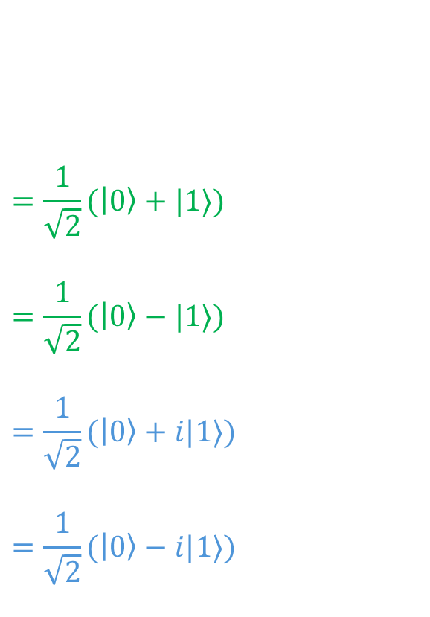
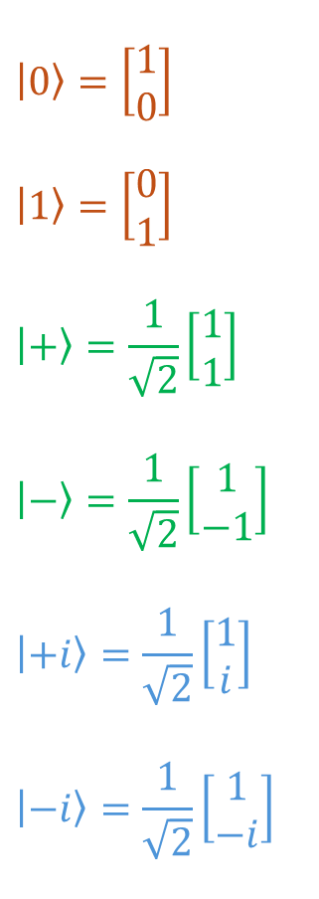
Qubit States
$$\left|0\right\rangle =\left[\begin{matrix}1 \\ 0\end{matrix}\right]$$
$$\left|1\right\rangle =\left[\begin{matrix}0 \\ 1\end{matrix}\right]$$
$$\left|+\right\rangle =\frac{1}{\sqrt{2}}\left[\begin{matrix}1 \\ 1\end{matrix}\right]$$
$$\left|−\right\rangle =\frac{1}{\sqrt{2}}\left[\begin{matrix}1 \\ −1\end{matrix}\right]$$
$$\left|+i\right\rangle =\frac{1}{\sqrt{2}}\left[\begin{matrix}1 \\ i\end{matrix}\right]$$
$$\left|−i\right\rangle =\frac{1}{\sqrt{2}}\left[\begin{matrix}1 \\ −i\end{matrix}\right]$$
$$=\frac{1}{\sqrt{2}}(\left|0\right\rangle +|1⟩)$$
$$=\frac{1}{\sqrt{2}}(\left|0\right\rangle −|1⟩)$$
$$=\frac{1}{\sqrt{2}}(\left|0\right\rangle +i|1⟩)$$
$$=\frac{1}{\sqrt{2}}(\left|0\right\rangle −i|1⟩)$$
Z basis
X basis
Y basis

Slide 11
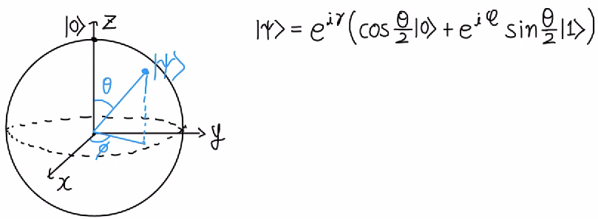
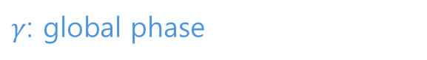
Bloch Sphere
$γ$: global phase

Slide 12
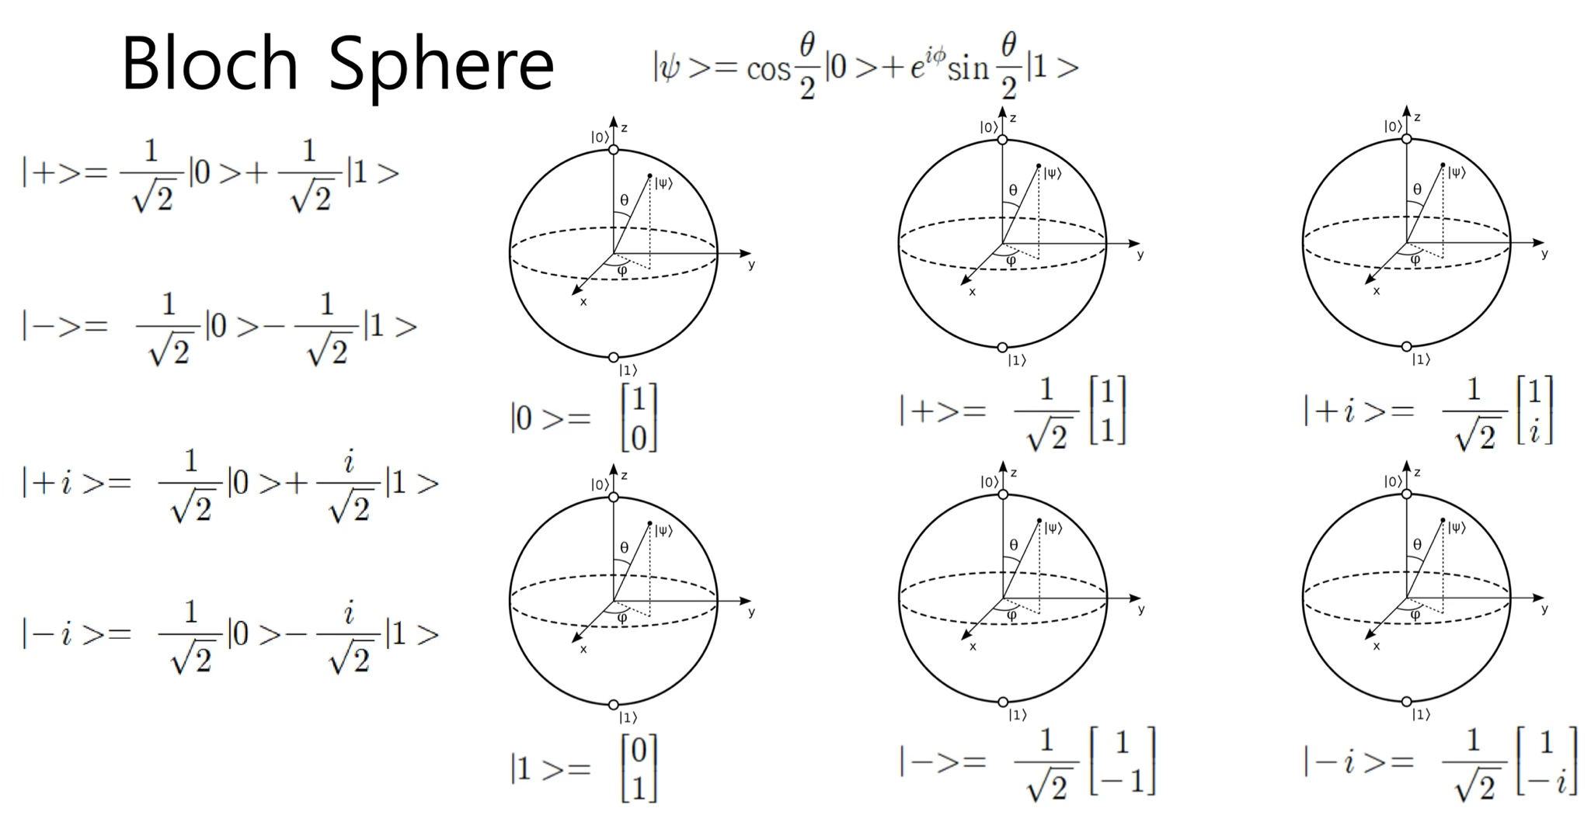
Bloch Sphere

Slide 13
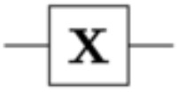
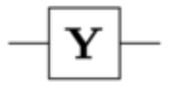
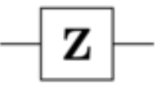
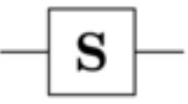
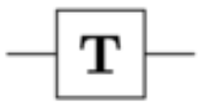
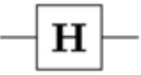

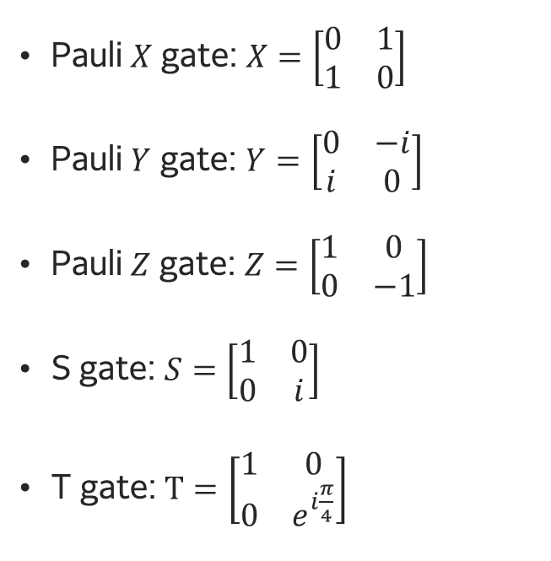
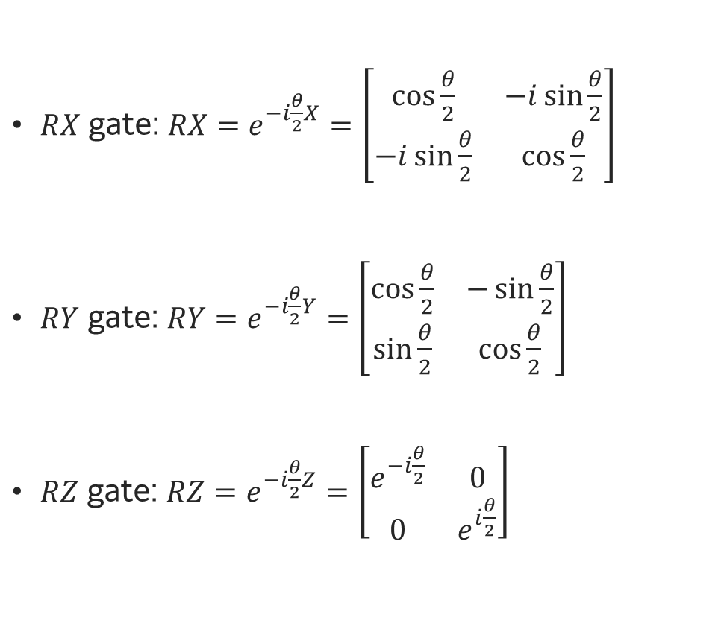
Single Qubit Gates
Quantum gates are Unitary operator
$RX$ gate: $RX=e^{−i\frac{θ}{2}X}=\left[\begin{matrix}cos⁡\frac{θ}{2} & −i\sin{\frac{θ}{2}} \\ −i\sin{\frac{θ}{2}} & cos⁡\frac{θ}{2}\end{matrix}\right]$
$RY$ gate: $RY=e^{−i\frac{θ}{2}Y}=\left[\begin{matrix}cos⁡\frac{θ}{2} & −\sin{\frac{θ}{2}} \\ \sin{\frac{θ}{2}} & cos⁡\frac{θ}{2}\end{matrix}\right]$
$RZ$ gate: $RZ=e^{−i\frac{θ}{2}Z}=\left[\begin{matrix}e^{−i\frac{θ}{2}} & 0 \\ 0 & e^{i\frac{θ}{2}}\end{matrix}\right]$
Pauli $X$ gate: $X=\left[\begin{matrix}0 & 1 \\ 1 & 0\end{matrix}\right]$
Pauli $Y$ gate: $Y=\left[\begin{matrix}0 & −i \\ i & 0\end{matrix}\right]$
Pauli $Z$ gate: $Z=\left[\begin{matrix}1 & 0 \\ 0 & −1\end{matrix}\right]$
S gate: $S=\left[\begin{matrix}1 & 0 \\ 0 & i\end{matrix}\right]$
T gate: $T=\left[\begin{matrix}1 & 0 \\ 0 & e^{i\frac{π}{4}}\end{matrix}\right]$
Hadamard gate: $H=\frac{1}{\sqrt{2}}\left[\begin{matrix}1 & 1 \\ 1 & −1\end{matrix}\right]$

Slide 14
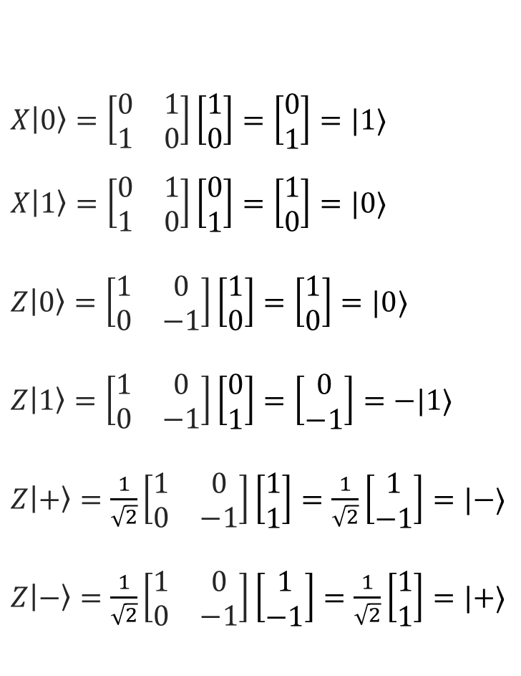
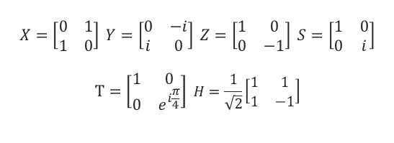
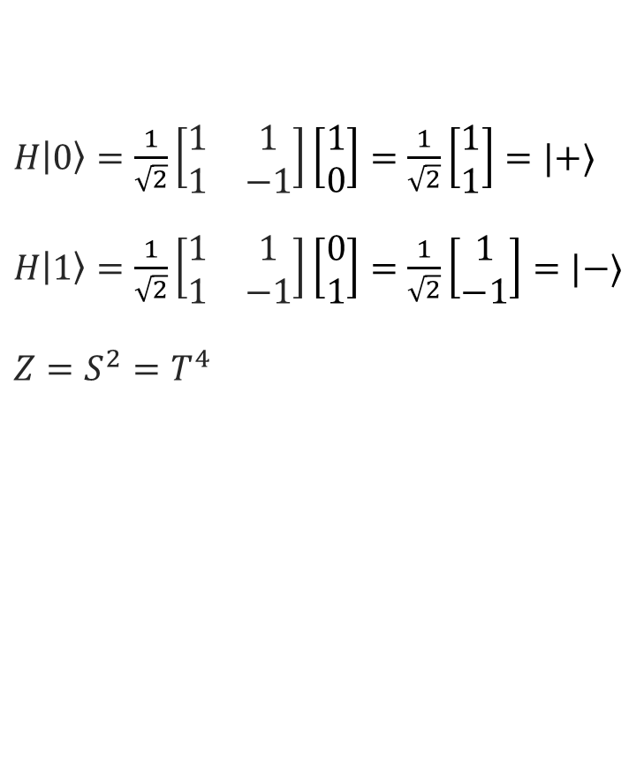
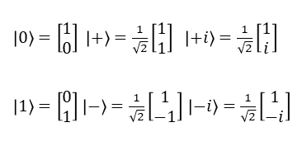
Single Qubit Gates
$\left|0\right\rangle =\left[\begin{matrix}1 \\ 0\end{matrix}\right]$ $\left|+\right\rangle =\frac{1}{\sqrt{2}}\left[\begin{matrix}1 \\ 1\end{matrix}\right]$ $\left|+i\right\rangle =\frac{1}{\sqrt{2}}\left[\begin{matrix}1 \\ i\end{matrix}\right]$
$\left|1\right\rangle =\left[\begin{matrix}0 \\ 1\end{matrix}\right]$ $\left|−\right\rangle =\frac{1}{\sqrt{2}}\left[\begin{matrix}1 \\ −1\end{matrix}\right]$ $\left|−i\right\rangle =\frac{1}{\sqrt{2}}\left[\begin{matrix}1 \\ −i\end{matrix}\right]$
$$X=\left[\begin{matrix}0 & 1 \\ 1 & 0\end{matrix}\right] Y=\left[\begin{matrix}0 & −i \\ i & 0\end{matrix}\right] Z=\left[\begin{matrix}1 & 0 \\ 0 & −1\end{matrix}\right] S=\left[\begin{matrix}1 & 0 \\ 0 & i\end{matrix}\right]$$
$$T=\left[\begin{matrix}1 & 0 \\ 0 & e^{i\frac{π}{4}}\end{matrix}\right] H=\frac{1}{\sqrt{2}}\left[\begin{matrix}1 & 1 \\ 1 & −1\end{matrix}\right]$$
$X\left|0\right\rangle =\left[\begin{matrix}0 & 1 \\ 1 & 0\end{matrix}\right]\left[\begin{matrix}1 \\ 0\end{matrix}\right]=\left[\begin{matrix}0 \\ 1\end{matrix}\right]=|1⟩$ $X\left|1\right\rangle =\left[\begin{matrix}0 & 1 \\ 1 & 0\end{matrix}\right]\left[\begin{matrix}0 \\ 1\end{matrix}\right]=\left[\begin{matrix}1 \\ 0\end{matrix}\right]=|0⟩$
$Z\left|0\right\rangle =\left[\begin{matrix}1 & 0 \\ 0 & −1\end{matrix}\right]\left[\begin{matrix}1 \\ 0\end{matrix}\right]=\left[\begin{matrix}1 \\ 0\end{matrix}\right]=|0⟩$
$Z\left|1\right\rangle =\left[\begin{matrix}1 & 0 \\ 0 & −1\end{matrix}\right]\left[\begin{matrix}0 \\ 1\end{matrix}\right]=\left[\begin{matrix}0 \\ −1\end{matrix}\right]=−|1⟩$
$Z\left|+\right\rangle =\frac{1}{\sqrt{2}}\left[\begin{matrix}1 & 0 \\ 0 & −1\end{matrix}\right]\left[\begin{matrix}1 \\ 1\end{matrix}\right]=\frac{1}{\sqrt{2}}\left[\begin{matrix}1 \\ −1\end{matrix}\right]=|−⟩$
$Z\left|−\right\rangle =\frac{1}{\sqrt{2}}\left[\begin{matrix}1 & 0 \\ 0 & −1\end{matrix}\right]\left[\begin{matrix}1 \\ −1\end{matrix}\right]=\frac{1}{\sqrt{2}}\left[\begin{matrix}1 \\ 1\end{matrix}\right]=|+⟩$
$H\left|0\right\rangle =\frac{1}{\sqrt{2}}\left[\begin{matrix}1 & 1 \\ 1 & −1\end{matrix}\right]\left[\begin{matrix}1 \\ 0\end{matrix}\right]=\frac{1}{\sqrt{2}}\left[\begin{matrix}1 \\ 1\end{matrix}\right]=|+⟩$ $H\left|1\right\rangle =\frac{1}{\sqrt{2}}\left[\begin{matrix}1 & 1 \\ 1 & −1\end{matrix}\right]\left[\begin{matrix}0 \\ 1\end{matrix}\right]=\frac{1}{\sqrt{2}}\left[\begin{matrix}1 \\ −1\end{matrix}\right]=|−⟩$
$Z=S^{2}=T^{4}$

Slide 15
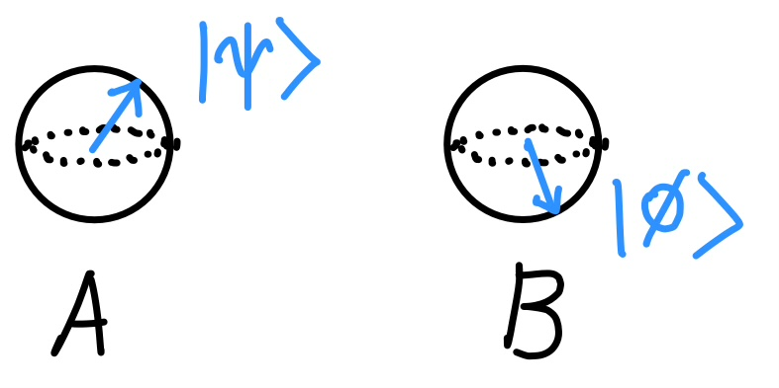
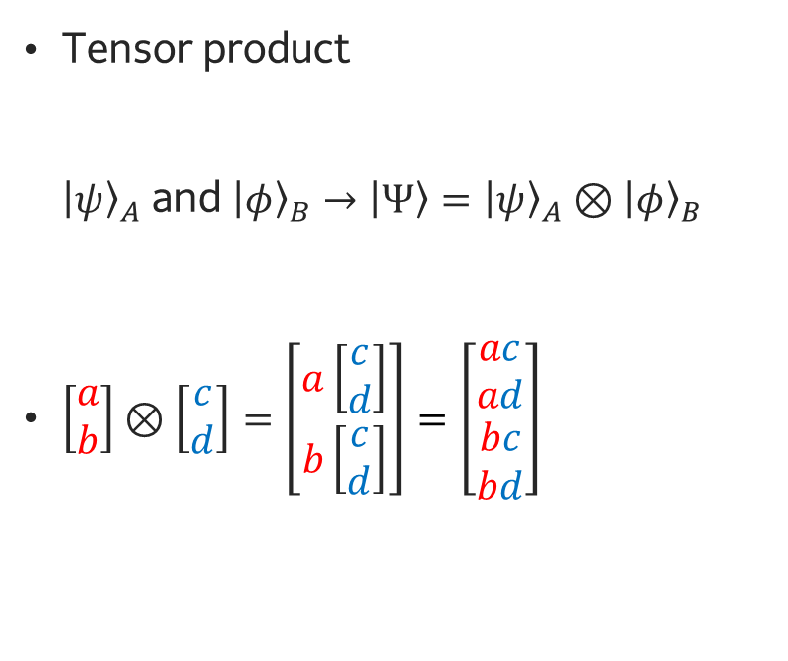
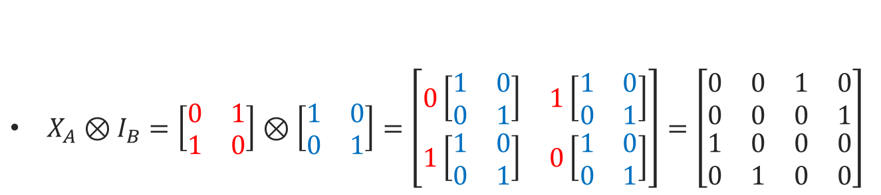
Multi-qubit Systems
Tensor product ${\left|ψ\right\rangle }_{A}$ and ${\left|φ\right\rangle }_{B}$ $→$ $\left|Ψ\right\rangle ={\left|ψ\right\rangle }_{A}⊗{\left|φ\right\rangle }_{B}$
$\left[\begin{matrix}a \\ b\end{matrix}\right]⊗\left[\begin{matrix}c \\ d\end{matrix}\right]=\left[\begin{matrix}a\left[\begin{matrix}c \\ d\end{matrix}\right] \\ b\left[\begin{matrix}c \\ d\end{matrix}\right]\end{matrix}\right]=\left[\begin{matrix}\begin{matrix}ac \\ ad\end{matrix} \\ \begin{matrix}bc \\ bd\end{matrix}\end{matrix}\right]$
$X_{A}⊗I_{B}=\left[\begin{matrix}0 & 1 \\ 1 & 0\end{matrix}\right]⊗\left[\begin{matrix}1 & 0 \\ 0 & 1\end{matrix}\right]=\left[\begin{matrix}0\left[\begin{matrix}1 & 0 \\ 0 & 1\end{matrix}\right] & 1\left[\begin{matrix}1 & 0 \\ 0 & 1\end{matrix}\right] \\ 1\left[\begin{matrix}1 & 0 \\ 0 & 1\end{matrix}\right] & 0\left[\begin{matrix}1 & 0 \\ 0 & 1\end{matrix}\right]\end{matrix}\right]=\left[\begin{matrix}\begin{matrix}0 & 0 \\ 0 & 0\end{matrix} & \begin{matrix}1 & 0 \\ 0 & 1\end{matrix} \\ \begin{matrix}1 & 0 \\ 0 & 1\end{matrix} & \begin{matrix}0 & 0 \\ 0 & 0\end{matrix}\end{matrix}\right]$

Slide 16
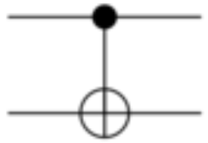
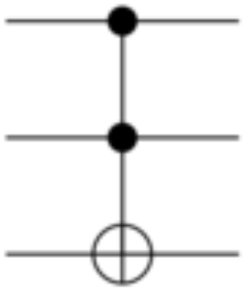
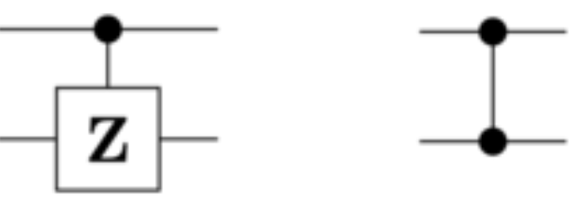
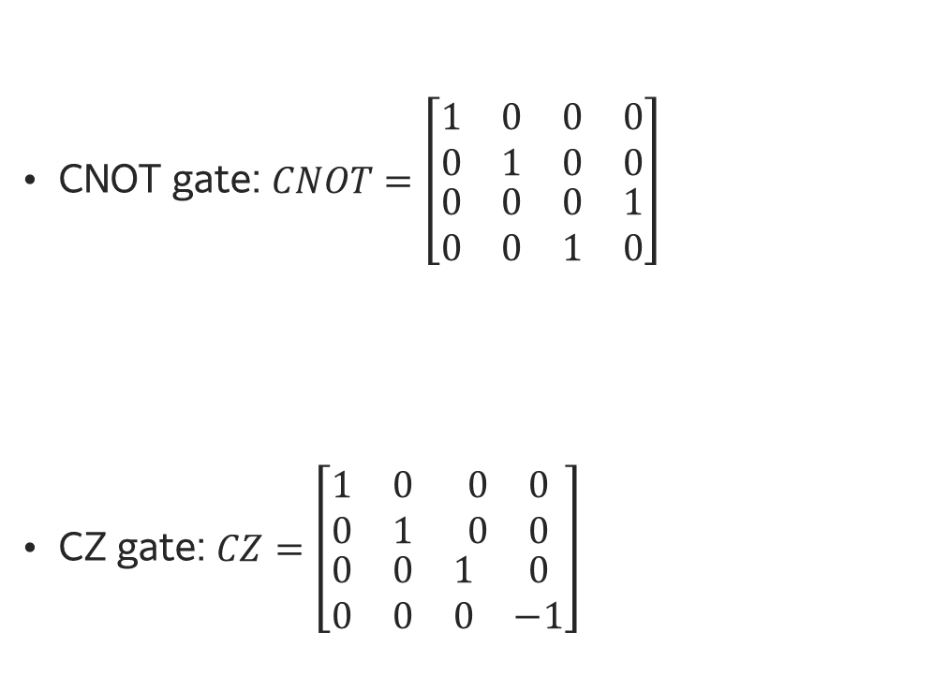
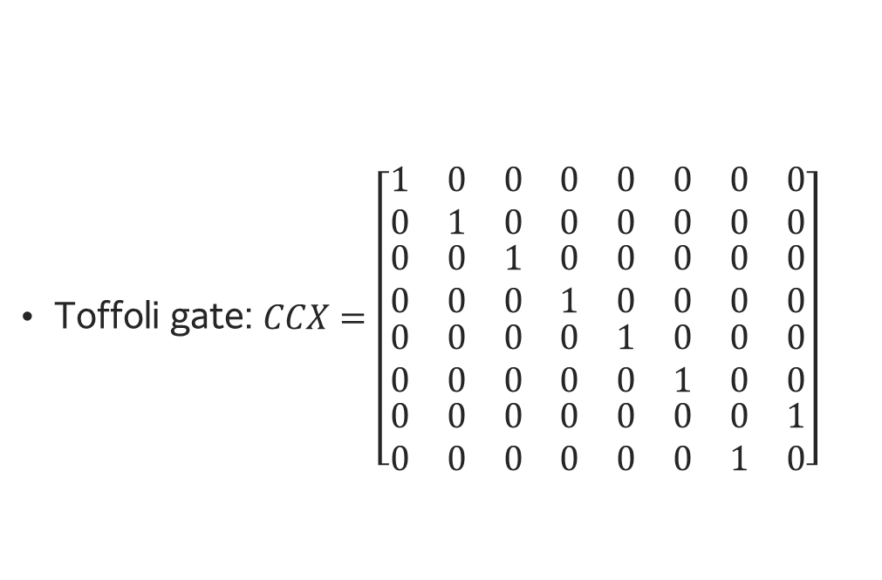
Multi-qubit Gates
Toffoli gate: $CCX=\left[\begin{matrix}\begin{matrix}\begin{matrix}1 & 0 \\ 0 & 1\end{matrix} & \begin{matrix}0 & 0 \\ 0 & 0\end{matrix} \\ \begin{matrix}0 & 0 \\ 0 & 0\end{matrix} & \begin{matrix}1 & 0 \\ 0 & 1\end{matrix}\end{matrix} & \begin{matrix}\begin{matrix}0 & 0 \\ 0 & 0\end{matrix} & \begin{matrix}0 & 0 \\ 0 & 0\end{matrix} \\ \begin{matrix}0 & 0 \\ 0 & 0\end{matrix} & \begin{matrix}0 & 0 \\ 0 & 0\end{matrix}\end{matrix} \\ \begin{matrix}\begin{matrix}0 & 0 \\ 0 & 0\end{matrix} & \begin{matrix}0 & 0 \\ 0 & 0\end{matrix} \\ \begin{matrix}0 & 0 \\ 0 & 0\end{matrix} & \begin{matrix}0 & 0 \\ 0 & 0\end{matrix}\end{matrix} & \begin{matrix}\begin{matrix}1 & 0 \\ 0 & 1\end{matrix} & \begin{matrix}0 & 0 \\ 0 & 0\end{matrix} \\ \begin{matrix}0 & 0 \\ 0 & 0\end{matrix} & \begin{matrix}0 & 1 \\ 1 & 0\end{matrix}\end{matrix}\end{matrix}\right]$
CNOT gate: $CNOT=\left[\begin{matrix}\begin{matrix}1 & 0 \\ 0 & 1\end{matrix} & \begin{matrix}0 & 0 \\ 0 & 0\end{matrix} \\ \begin{matrix}0 & 0 \\ 0 & 0\end{matrix} & \begin{matrix}0 & 1 \\ 1 & 0\end{matrix}\end{matrix}\right]$
CZ gate: $CZ=\left[\begin{matrix}\begin{matrix}1 & 0 \\ 0 & 1\end{matrix} & \begin{matrix}0 & 0 \\ 0 & 0\end{matrix} \\ \begin{matrix}0 & 0 \\ 0 & 0\end{matrix} & \begin{matrix}1 & 0 \\ 0 & −1\end{matrix}\end{matrix}\right]$

Slide 17
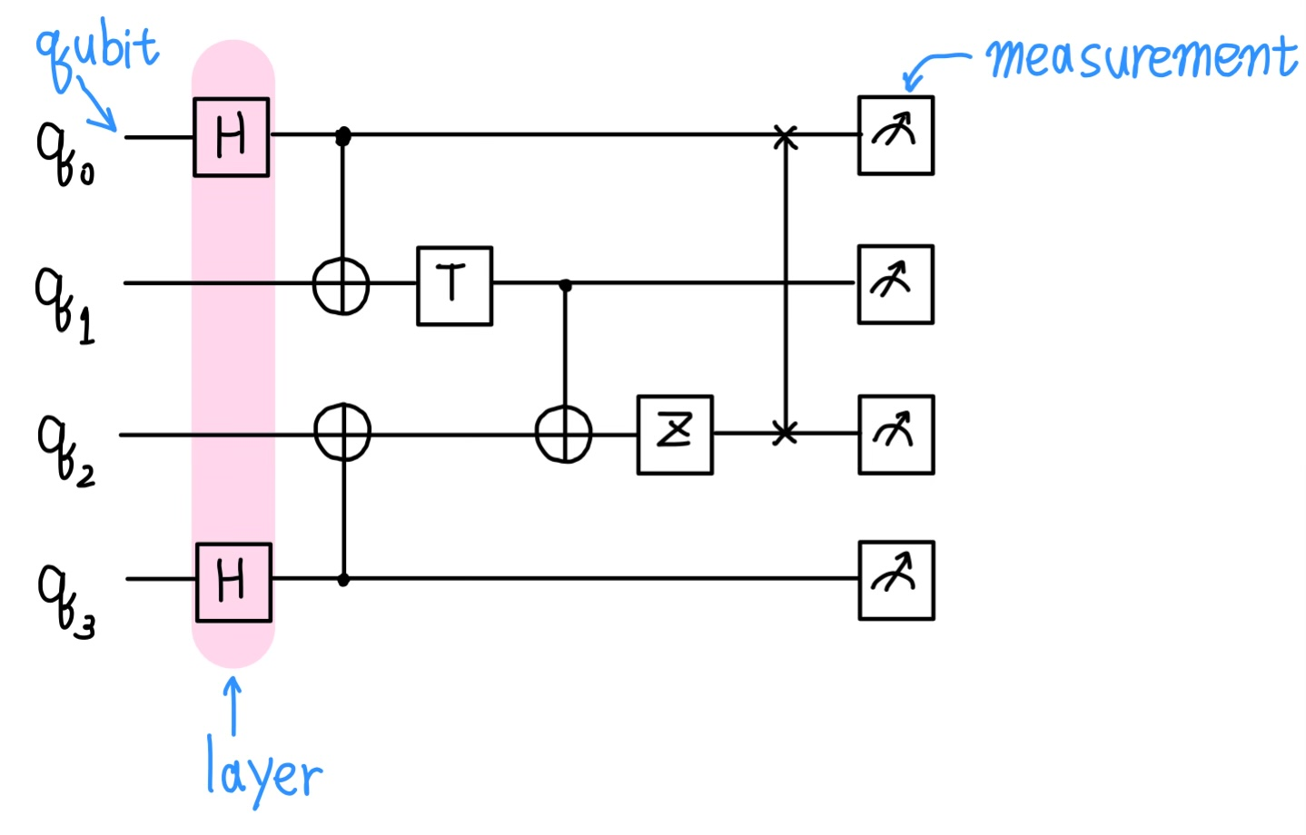
Quantum Circuit
A quantum circuit is a model of quantum computation where a computation consists of a sequence of qubit initializations, quantum gates, and measurements.

Slide 18
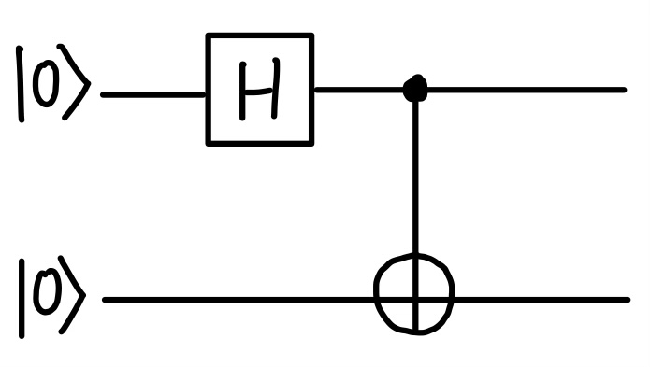
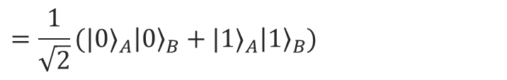
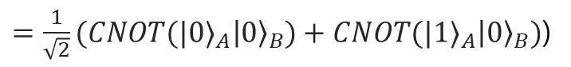
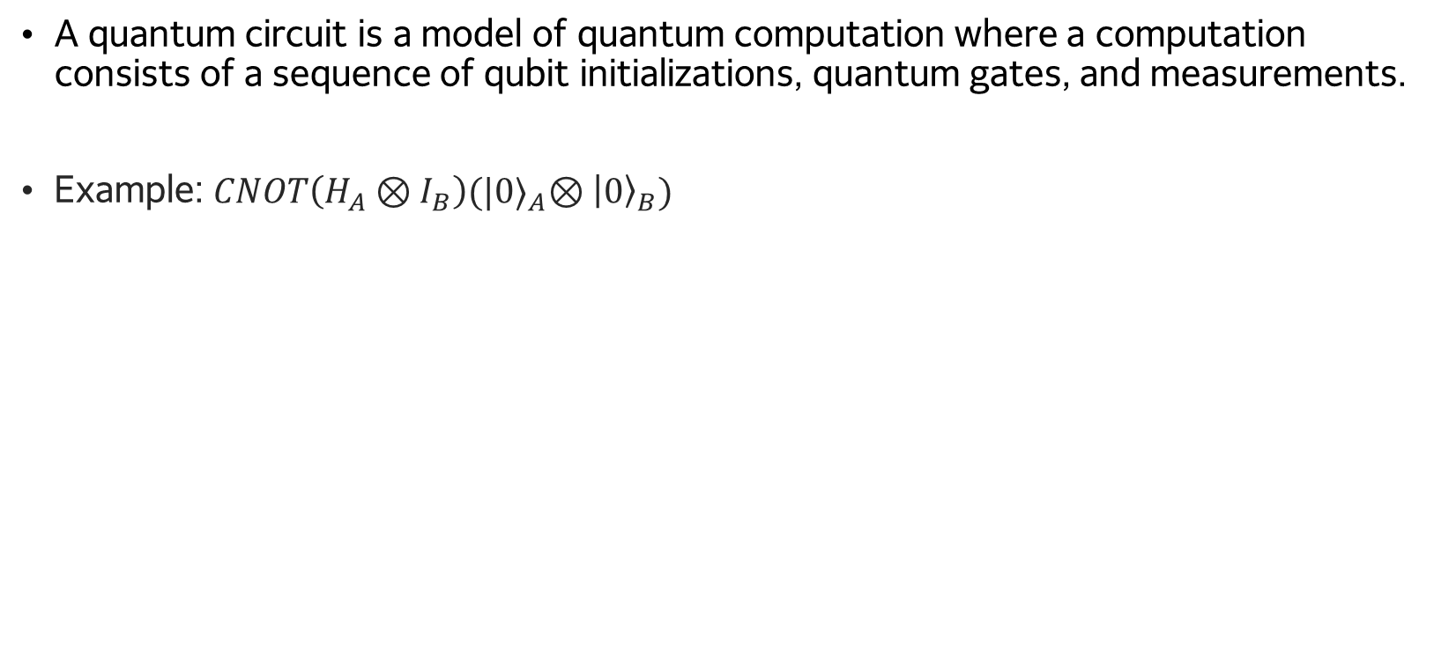
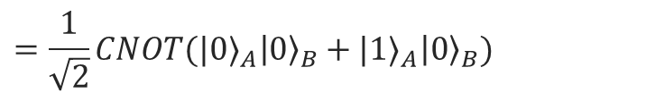
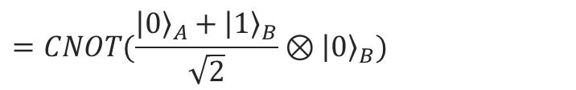
Quantum Circuit
A quantum circuit is a model of quantum computation where a computation consists of a sequence of qubit initializations, quantum gates, and measurements.
Example: $CNOT\left(H_{A}⊗I_{B}\right){(|0⟩}_{A}⊗{\left|0\right\rangle }_{B})$
$$CNOT\left(H_{A}⊗I_{B}\right){(|0⟩}_{A}⊗{\left|0\right\rangle }_{B})=CNOT(H_{A}{\left|0\right\rangle }_{A}⊗I_{B}{\left|0\right\rangle }_{B})$$
$$=CNOT(\frac{{\left|0\right\rangle }_{A}+{\left|1\right\rangle }_{B}}{\sqrt{2}}⊗{\left|0\right\rangle }_{B})$$
$$=\frac{1}{\sqrt{2}}CNOT{(|0⟩}_{A}{\left|0\right\rangle }_{B}+{|1⟩}_{A}{\left|0\right\rangle }_{B})$$
$=\frac{1}{\sqrt{2}}(CNOT{(|0⟩}_{A}{\left|0\right\rangle }_{B})+CNOT({|1⟩}_{A}{\left|0\right\rangle }_{B})$)
$$=\frac{1}{\sqrt{2}}{(|0⟩}_{A}{\left|0\right\rangle }_{B}+{|1⟩}_{A}{\left|1\right\rangle }_{B})$$

Slide 19
Ⅱ. Introduction to Qiskit & IBM Quantum Platform

Slide 20

Qiskit
Qiskit SDK is an open-source SDK for working with quantum computers at the level of quantum circuits, operators, and primitives.
https://github.com/Qiskit/qiskit
https://docs.quantum-computing.ibm.com/
Version 1.0 released Feb 2024
Qiskit Patterns is a framework for breaking down domain-specific problems into stage.
Qiskit Runtime is a cloud-based service for executing quantum computations on IBM Quantum hardware.
https://github.com/Qiskit/qiskit-ibm-runtime
https://docs.quantum-computing.ibm.com/
Runtime Primitives version 2
Released March 2024
The Qiskit Ecosystem is a collection of software and projects that build on or extend Qiskit
http://qiskit.github.io/ecosystem
source: Qiskit Global Summer School Lecture 1

Slide 21
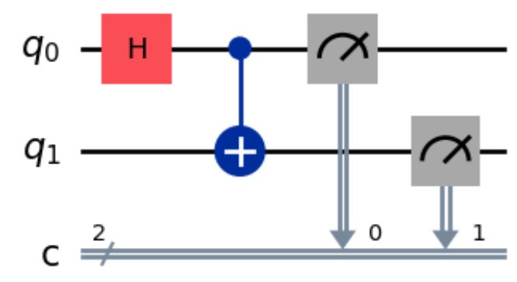
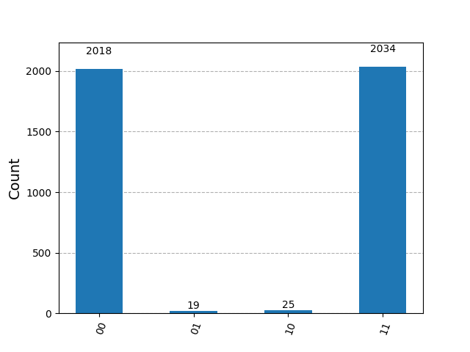
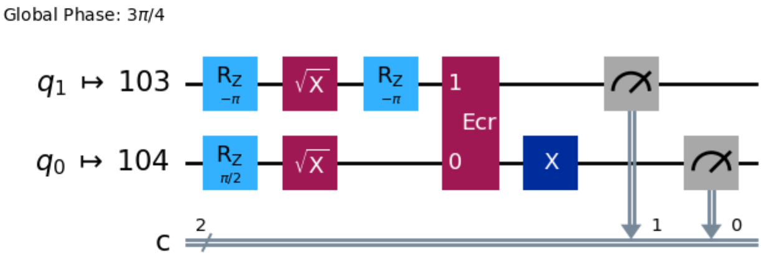
Qiskit

Slide 22
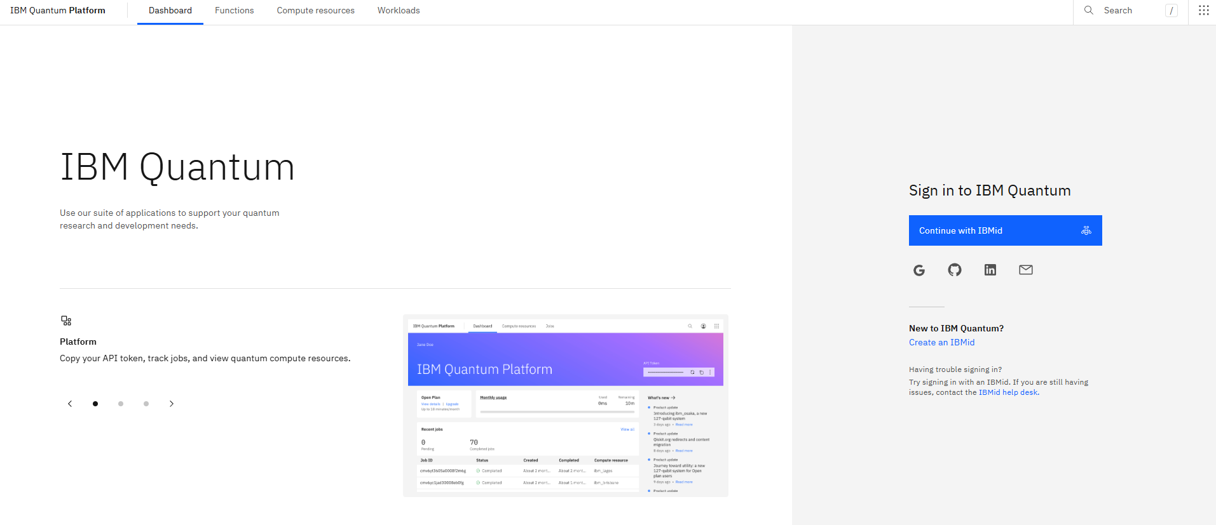
IBM Quantum Platform
https://quantum.ibm.com/

Slide 23
Ⅲ. Setting Up the Qiskit Development Environment

Slide 24
Virtual Environment
Virtual environments are used to create isolated workspaces.
As the number of dependencies between libraries increases, conflicts between libraries can become more frequent, and in the worst case, you might have to delete everything and set up the development environment from scratch.
To avoid these issues, it’s helpful to create a separate virtual environment for each project, where only the necessary libraries are installed.

Slide 25
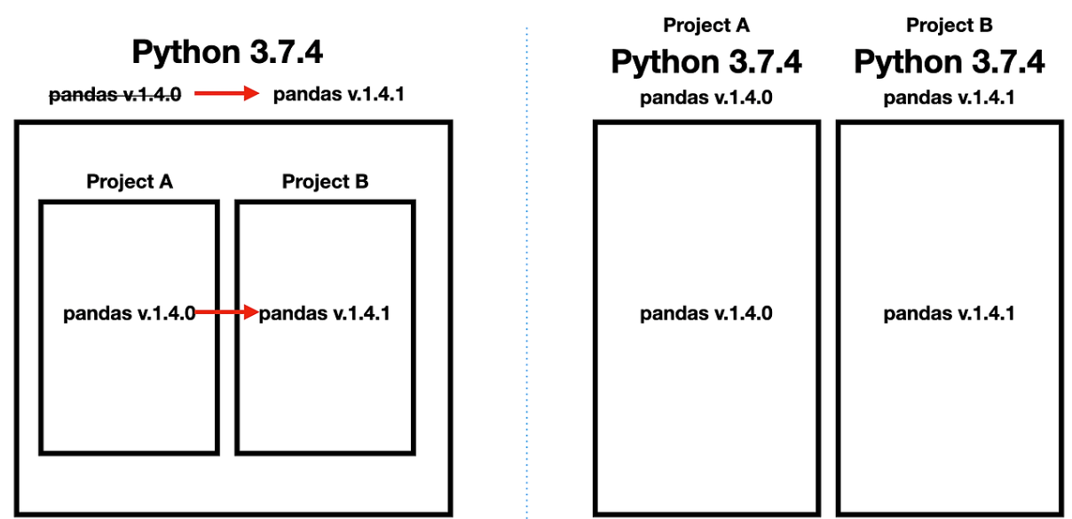
Virtual Environment
pandas v.1.4.1
Error!!
<Virtual Environment X>
<Virtual Environment O>
image source: https://heytech.tistory.com/316

Slide 26
Setting Up the Environment
Contents of “Setting Qiskit Development Environment.docx”
Why Virtual Environments Are Necessary
Installing Anaconda
Getting Familiar with Anaconda Prompt
Creating a Virtual Environment
Activating the Virtual Environment
Installing Libraries in the Virtual Environment
Running and Testing Jupyter Notebook

Slide 27
Ⅳ. Designing Quantum Circuits

Slide 28
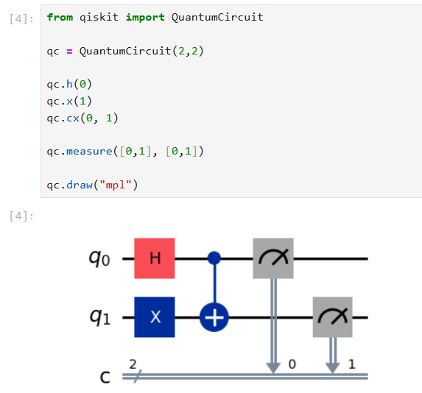
QuantumCircuit Class
To build a circuit:
Initialize a quantum circuit object
Perform operations on those qubits

Slide 29
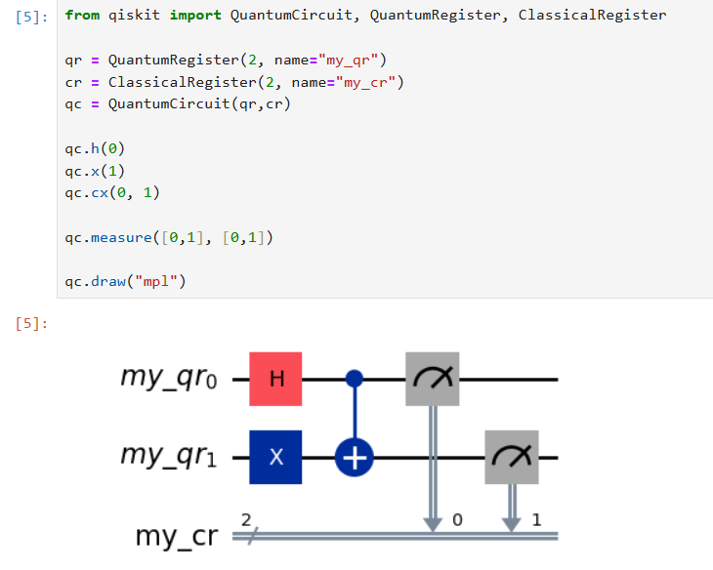
QuantumCircuit Class

Slide 30
Simulator and Real Backend
Simulators
- Software-based backend that mimic the behavior of a quantum computer
They are usually used for testing and experimenting with quantum algorithms without relying on real quantum hardware.
As the number of qubits increases, the classical resources required to simulate them grow exponentially, making simulators impractical for large-scale systems
Real backend
Actual quantum processors accessible via the cloud.
They allow users to run quantum circuits on physical quantum hardware.
Subject to real-world constraints, such as noise, decoherence, and gate errors.
Limited by hardware-specific characteristics, including qubit connectivity (topology) and maximum number of qubits.

Slide 31
Simulator and Real Backend
Example: qiskit_aer.AerSimulator
Simulators
- Software-based backend that mimic the behavior of a quantum computer
They are usually used for testing and experimenting with quantum algorithms without relying on real quantum hardware.
As the number of qubits increases, the classical resources required to simulate them grow exponentially, making simulators impractical for large-scale systems
Real backend
Actual quantum processors accessible via the cloud.
They allow users to run quantum circuits on physical quantum hardware.
Subject to real-world constraints, such as noise, decoherence, and gate errors.
Limited by hardware-specific characteristics, including qubit connectivity (topology) and maximum number of qubits.
Example: ibm_sherbrooke

Slide 32
Ⅴ. Implementing Classical Feedforward and Control Flow

Slide 33
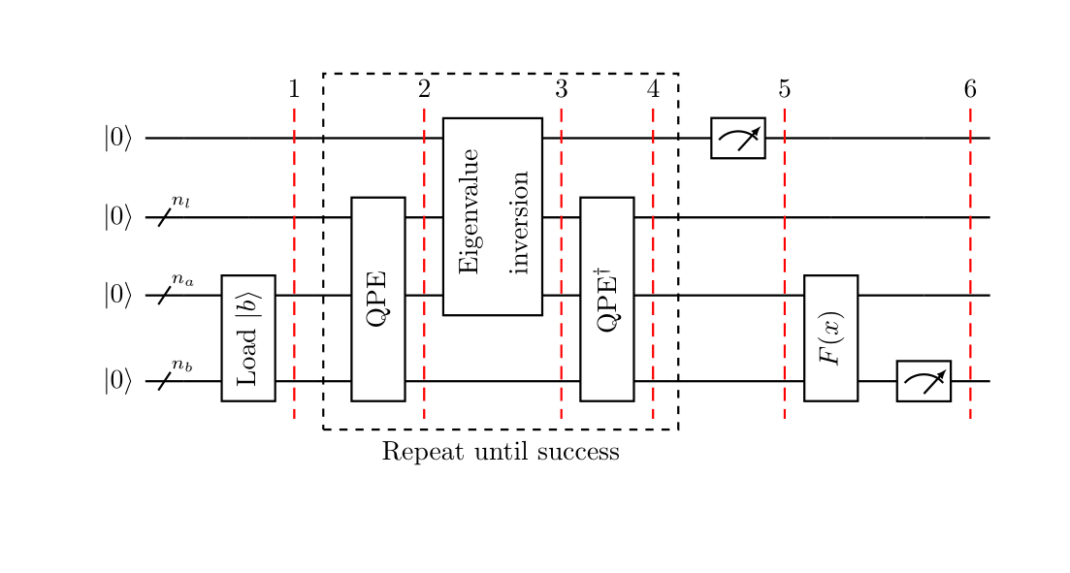
Classical Feedforward and Control Flow
Classical feedforward and control flow are essential concepts in quantum computing that involve using classical measurement results to dynamically control quantum operations.
Many quantum algorithms, such as the HHL algorithm, require post-measurement processing to determine subsequent actions
image source: qiskit-textbook

Slide 34
Types of Statements for Classical Feedforward
If statement
Switch statement
For loop
While loop
Break loop & Continue loop

Slide 35
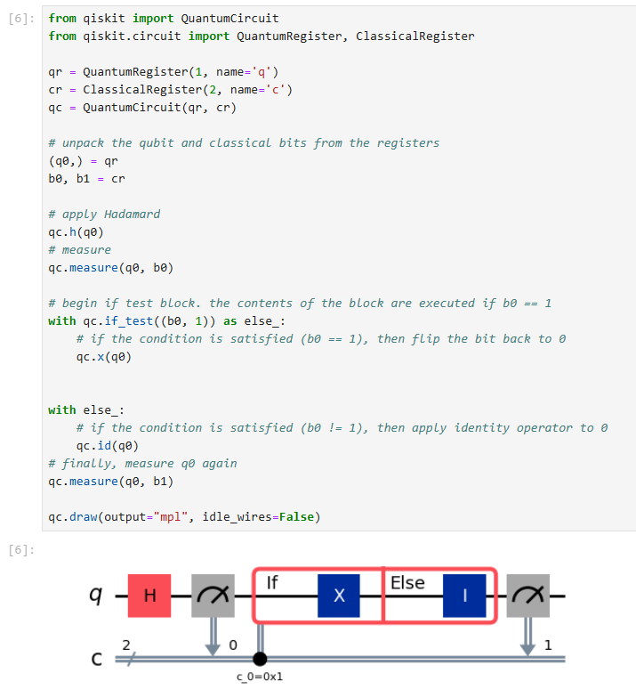
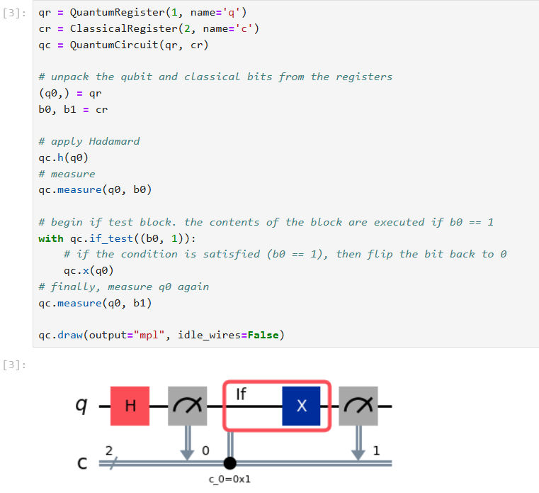
If statement

Slide 36

Switch statement

Slide 37

Switch statement

Slide 38

For loop

Slide 39

While loop

Slide 40

Break loop

